Slide 1
SPECIFICATION
FOR
APPROVAL
( |  | ) | Preliminary Specification
( |  | ) | Final Specification
◆
Title | 10.1” HD TFT LCD
Customer | HP
MODEL
SUPPLIER | LG Display Co., Ltd.
*MODEL | LP101WH1
Suffix | TLB4
*When you obtain standard approval, please use the above model name without suffix
 | APPROVED BY | SIGNATURE
 | /
 | /
 | /
Please return 1 copy for your confirmation with your signature and comments.
APPROVED BY
SIGNATURE
C. J. Jun / Manager
REVIEWED BY
S. W. Paeng / Manager
PREPARED BY
P. A. Choi / Engineer
Products Engineering Dept.
LG Display Co., Ltd
<number> / 27

Slide 2
Contents
No | ITEM | Page
 | COVER | 1
 | CONTENTS | 2
 | RECORD OF REVISIONS | 3
1 | GENERAL DESCRIPTION | 4
2 | ABSOLUTE MAXIMUM RATINGS | 5
3 | ELECTRICAL SPECIFICATIONS
3-1 | ELECTRICAL CHARACTREISTICS | 6
3-2 | INTERFACE CONNECTION | 7
3-3 | LVDS SIGNAL TIMING SPECIFICATIONS | 8
3-4 | SIGNAL TIMING SPECIFICATIONS | 10
3-5 | SIGNAL TIMING WAVEFORMS | 10
3-6 | COLOR INPUT DATA REFERNECE | 11
3-7 | POWER SEQUENCE | 12
4 | OPTICAL SFECIFICATIONS | 13
5 | MECHANICAL CHARACTERISTICS | 16
6 | RELIABLITY | 20
7 | INTERNATIONAL STANDARDS
7-1 | SAFETY | 21
7-2 | EMC | 21
8 | PACKING
8-1 | DESIGNATION OF LOT MARK | 22
8-2 | PACKING FORM | 22
9 | PRECAUTIONS | 23
A | APPENDIX. Enhanced Extended Display Identification Data | 25
<number> / 27

Slide 3
RECORD OF REVISIONS
Revision No | Revision Date | Page | Description | EDID ver
1.0 | Jun. 16. 2009 | All | First Draft (Final Specification) | -
<number> / 27

Slide 4

1. General Description
The LP101WH1 is a Color Active Matrix Liquid Crystal Display with an integral LED backlight system. The matrix employs a-Si Thin Film Transistor as the active element. It is a transmissive type display operating in the normally white mode. This TFT-LCD has 10.1inches diagonally measured active display area with HD resolution(1366 horizontal by 768 vertical pixel array). Each pixel is divided into Red, Green and Blue sub-pixels or dots which are arranged in vertical stripes. Gray scale or the brightness of the sub-pixel color is determined with a 6-bit gray scale signal for each dot, thus, presenting a palette of more than 262,144 colors.
The LP101WH1 has been designed to apply the interface method that enables low power, high speed, low EMI.
The LP101WH1 is intended to support applications where thin thickness, low power are critical factors and graphic displays are important. In combination with the vertical arrangement of the sub-pixels, the LP101WH1 characteristics provide an excellent flat display for office automation products such as Notebook PC.
CN1 User connector 40 Pin
EDID
BLOCK
1
GIP(Gate In Panel)
POWER
BLOCK
TFT-LCD Panel
(1366 x 768)
LVDS &
Timing
Control
Block
1
1366
768
Source Driver Circuit
PWM & VBL
LED Backlight Ass’y
Control & Data
Power
EDID signal & Power
General Features
Active Screen Size | 10.1 inches diagonal
Outline Dimension | 235(H) × 143(V) × .5.2(D,Max.) [mm]
Pixel Pitch | 0.16305mm × 0.16305 mm
Pixel Format | 1366 horiz. By 768 vert. Pixels RGB strip arrangement
Color Depth | 6-bit, 262,144 colors
Luminance, White | 200 cd/m²(Typ.5 point)
Power Consumption | Total 3.46 Watt(Typ.) @ LCM circuit 1.16 Watt(Typ.), B/L input 2.3 Watt(Typ.) (W/O LED Driver)
Weight | 200g (Max.)
Display Operating Mode | Transmissive mode, normally white
Surface Treatment | Anti-Glare treatment of the front polarizer
RoHS Comply | Yes
<number> / 27

Slide 5
2. Absolute Maximum Ratings
The following are maximum values which, if exceeded, may cause faulty operation or damage to the unit.
Table 1. ABSOLUTE MAXIMUM RATINGS
Parameter | Symbol | Values |  | Units | Notes
 |  | Min | Max
Power Input Voltage | VCC | -0.3 | 4.0 | Vdc | at 25 ± 5°C
Operating Temperature | TOP | 0 | 50 | °C | 1
Storage Temperature | HST | -20 | 60 | °C | 1
Operating Ambient Humidity | HOP | 10 | 90 | %RH | 1
Storage Humidity | HST | 10 | 90 | %RH | 1
Note : 1. Temperature and relative humidity range are shown in the figure below.
Wet bulb temperature should be 39°C Max, and no condensation of water.
90%
80%
60
60%
Wet Bulb
Temperature [℃]
50
Humidity[(%)RH]
Storage
40
40%
30
Operation
10
20
20%
0
10%
-20
0
10
20
30
40
50
60
70
80
Dry Bulb Temperature [℃]
<number> / 27

Slide 6

3. Electrical Specifications
3-1. Electrical Characteristics
The LP101WH1 requires two power inputs. One is employed to power the LCD electronics and to drive the TFT array and liquid crystal. The second input which powers the LED BL.
Table 2. ELECTRICAL CHARACTERISTICS
Parameter | Symbol | Values |  |  | Unit | Notes
 |  | Min | Typ | Max
MODULE :
Power Supply Input Voltage | VCC | 3.0 | 3.3 | 3.6 | V_{DC}
Power Supply Input Current | I_{CC} | - | 350 | 402 | mA | 1
Power Consumption | Pc | - | 1.16 | 1.33 | Watt | 1
Differential Impedance | Zm | 90 | 100 | 110 | Ohm | 2
LED Backlight ( With LED Driver ) :
LED Driver ( @12V ) | P_{DRIVER} | - | 0.21 | 0.25 | Watt
Operating Voltage | V_{LED} | - | 28.85 | 32.4 | V
Operating Current per string | I_{LED} | - | 20 |  | mA | 3
Power Consumption | P_{BL} | - | 2.3 | 2.592 | Watt | 4
Life Time |  | 10,000 |  |  | Hrs | 5
Note)
1. The specified current and power consumption are under the Vcc = 3.3V , 25℃, fv = 60Hz condition
whereas Mosaic pattern is displayed and fv is the frame frequency.
2. This impedance value is needed to proper display and measured form LVDS Tx to the mating connector.
3. The typical operating current is for the typical surface luminance (L_{WH}) in optical characteristics.
I_{LED} is the current of each LED’s string, LED backlight has 4 strings on it.
4. The LED power consumption shown above does not include power of external LED driver circuit
for typical current condition.
5. The life time is determined as the time at which brightness of LED is 50% compare to that of initial value
at the typical LED current.
<number> / 27

Slide 7
3-2. Interface Connection
This LCD employs one interface connection, a 40 pin connector is used for the module electronics interface.
Table 3. MODULE CONNECTOR PIN CONFIGURATION (CN1)
Pin | Symbol | Description | Notes
1 | CT1/NC | Connector Test/No Connection(Reserved)
2 | VDD | +3.3V Power Supply
3 | VDD | +3.3V Power Supply
4 | V_{EDID} | +3.3V EDID Power
5 | Test | Panel Self Test
6 | CLK_{EDID} | EDID Clock Input
7 | DATA_{EDID} | EDID Data Input
8 | RxIN0- | LVDS differential data input
9 | RxIN0+ | LVDS differential data input
10 | GND | Ground
11 | RxIN1- | LVDS differential data input
12 | RxIN1+ | LVDS differential data input
13 | GND | Ground
14 | RxIN2- | LVDS differential data input
15 | RxIN2+ | LVDS differential data input
16 | GND | Ground
17 | RxCLKIN- | LVDS differential clock input
18 | RxCLKIN+ | LVDS differential clock input
19 | GND | Ground
20 | NC | No Connection
21 | NC | No Connection
22 | GND | Ground
23 | NC | No Connection
24 | NC | No Connection
25 | GND | Ground
26 | NC | No Connection
27 | NC | No Connection
28 | GND | Ground
29 | NC | No Connection
30 | NC | No Connection
31 | VLED_GND | LED Ground
32 | VLED_GND | LED Ground
33 | VLED_GND | LED Ground
34 | CT2/NC | Connector Test/No Connection(Reserved)
35 | S_PWMIN | System PWM signal input(+3.3V swing)
36 | BL_ON | LED Enable(3.3V Input) [Note 1]
37 | NC | No Connection
38 | VLED | 7~21V LED Power Supply
39 | VLED | 7~21V LED Power Supply
40 | VLED | 7~21V LED Power Supply
1, Interface chips
1.1 LCD : SiW, 1port including
LVDS Receiver
1.2 System :
* Pin to Pin compatible with LVDS
2. Connector
2.1 LCD :I-PEX 20455-040E-0*
(Locking type)
or equivalent
2.2 Mating :
2.3 Connector pin arrangement
40
1
[LCD Module Rear View]
[Note 1]
On: 2.0V↑,Off:0~0.4V
<number> / 27

Slide 8
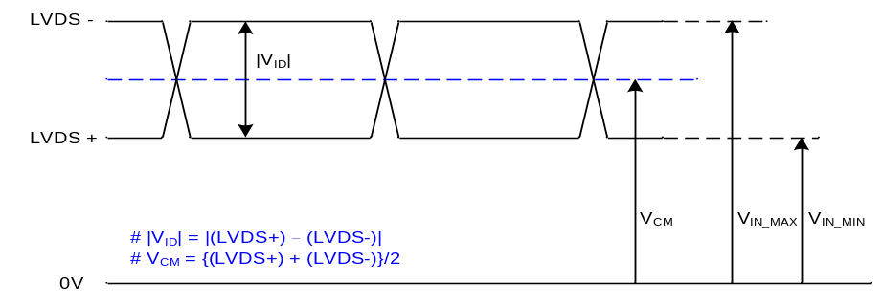
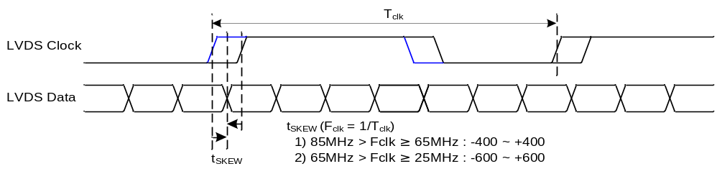
3-3. LVDS Signal Timing Specifications
3-3-1. DC Specification
Description | Symbol | Min | Max | Unit | Notes
LVDS Differential Voltage | |V_{ID}| | 100 | 600 | mV | -
LVDS Common mode Voltage | V_{CM} | 0.6 | 1.8 | V | -
LVDS Input Voltage Range | V_{IN} | 0.3 | 2.1 | V | -
3-3-2. AC Specification
Description | Symbol | Min | Max | Unit | Notes
LVDS Clock to Data Skew Margin | t_{SKEW} | 400 | + 400 | ps | 85MHz > Fclk ≥ 65MHz
 | t_{SKEW} | 600 | + 600 | ps | 65MHz > Fclk ≥ 25MHz
LVDS Clock to Clock Skew Margin (Even to Odd) | t_{SKEW_EO} | - 1/7 | + 1/7 | T_{clk} | -
Maximum deviation of input clock frequency during SSC | F_{DEV} | - | ± 3 | % | -
Maximum modulation frequency of input clock during SSC | F_{MOD} | - | 200 | KHz | -
<number> / 27

Slide 9
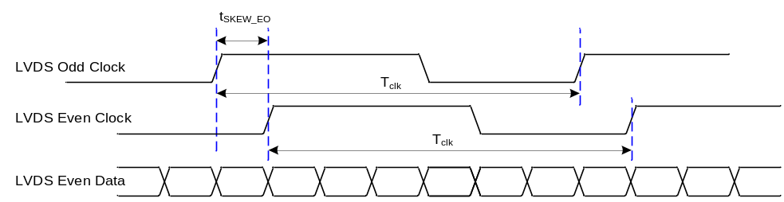
< Clock skew margin between channel >
Freq.
F_{max}
F_{center} * F_{DEV}
F_{center}
F_{min}
1
F_{MOD}
Time
< Spread Spectrum >
3-3-3. Data Format
- LVDS 1 Port
RCLK+
RA+/-
R
3
R
2
R
1
R
0
G
0
R
5
R
4
R
3
R
2
R
1
R
0
G
0
R
5
R
4
RB+/-
G
4
G
3
G
2
G
1
B
1
B
0
G
5
G
4
G
3
G
2
G
1
B
1
B
0
G
5
RC+/-
B
5
B
4
B
3
B
2
DE
VSYNC
HSYNC
B
5
B
4
B
3
B
2
DE
VSYNC
HSYNC
RD+/-
G
7
G
6
R
7
R
6
X
B
7
B
6
G
7
G
6
R
7
R
6
X
B
7
B
6
Previous
(
N
-
1
)
th Cycle
Current
(
Nth
)
Cycle
Next
(
N
+
1
)
th Cycle
< LVDS Data Format >
<number> / 27

Slide 10
3-4. Signal Timing Specifications
This is the signal timing required at the input of the User connector. All of the interface signal timing should be satisfied with the following specifications and specifications of LVDS Tx/Rx for its proper operation.
Table 5. TIMING TABLE
ITEM | Symbol |  | Min | Typ | Max | Unit | Note
DCLK | Frequency | f_{CLK} | - | 72.3 | - | MHz
Hsync | Period | Thp | 1470 | 1526 | 1586 | tCLK
 | Width | t_{WH} | 23 | 32 | 40
 | Width-Active | t_{WHA} | 1366 | 1366 | 1366
Vsync | Period | t_{VP} | 779 | 790 | 801 | tHP
 | Width | t_{WV} | 2 | 5 | 8
 | Width-Active | t_{WVA} | 768 | 768 | 768
Data Enable | Horizontal back porch | t_{HBP} | 72 | 80 | 124 | tCLK
 | Horizontal front porch | t_{HFP} | 8 | 48 | 48
 | Vertical back porch | t_{VBP} | 8 | 14 | 20 | tHP
 | Vertical front porch | t_{VFP} | 1 | 3 | 5
3-5. Signal Timing Waveforms
Condition : VCC =3.3V
Data Enable, Hsync, Vsync
High: 0.7VCC
Low: 0.3VCC
DCLK
tCLK
0.5 Vcc
Hsync
t_{HP}
t_{WH}
t_{HBP}
tWHA
t_{HFP}
Data Enable
t_{VP}
t_{WV}
Vsync
t_{VBP}
tWVA
t_{VFP}
Data Enable
<number> / 27

Slide 11
3-6. Color Input Data Reference
The brightness of each primary color (red,green and blue) is based on the 6-bit gray scale data input for the
color ; the higher the binary input, the brighter the color. The table below provides a reference for color
versus data input.
Table 7. COLOR DATA REFERENCE
Color |  | Input Color Data
 |  | RED MSB LSB | GREEN MSB LSB | BLUE MSB LSB
 |  | R5 R4 R3 R2 R1 R0 | G5 G4 G3 G2 G1 G0 | B5 B4 B3 B2 B1 B0
Basic Color | Black | 0 0 0 0 0 0 | 0 0 0 0 0 0 | 0 0 0 0 0 0
 | Red | 1 1 1 1 1 1 | 0 0 0 0 0 0 | 0 0 0 0 0 0
 | Green | 0 0 0 0 0 0 | 1 1 1 1 1 1 | 0 0 0 0 0 0
 | Blue | 0 0 0 0 0 0 | 0 0 0 0 0 0 | 1 1 1 1 1 1
 | Cyan | 0 0 0 0 0 0 | 1 1 1 1 1 1 | 1 1 1 1 1 1
 | Magenta | 1 1 1 1 1 1 | 0 0 0 0 0 0 | 1 1 1 1 1 1
 | Yellow | 1 1 1 1 1 1 | 1 1 1 1 1 1 | 0 0 0 0 0 0
 | White | 1 1 1 1 1 1 | 1 1 1 1 1 1 | 1 1 1 1 1 1
RED | RED (00) | 0 0 0 0 0 0 | 0 0 0 0 0 0 | 0 0 0 0 0 0
 | RED (01) | 0 0 0 0 0 1 | 0 0 0 0 0 0 | 0 0 0 0 0 0
 | … | … | … | …
 | RED (62) | 1 1 1 1 1 0 | 0 0 0 0 0 0 | 0 0 0 0 0 0
 | RED (63) | 1 1 1 1 1 1 | 0 0 0 0 0 0 | 0 0 0 0 0 0
GREEN | GREEN (00) | 0 0 0 0 0 0 | 0 0 0 0 0 0 | 0 0 0 0 0 0
 | GREEN (01) | 0 0 0 0 0 0 | 0 0 0 0 0 1 | 0 0 0 0 0 0
 | ... | … | … | …
 | GREEN (62) | 0 0 0 0 0 0 | 1 1 1 1 1 0 | 0 0 0 0 0 0
 | GREEN (63) | 0 0 0 0 0 0 | 1 1 1 1 1 1 | 0 0 0 0 0 0
BLUE | BLUE (00) | 0 0 0 0 0 0 | 0 0 0 0 0 0 | 0 0 0 0 0 0
 | BLUE (01) | 0 0 0 0 0 0 | 0 0 0 0 0 0 | 0 0 0 0 0 1
 | … | … | … | …
 | BLUE (62) | 0 0 0 0 0 0 | 0 0 0 0 0 0 | 1 1 1 1 1 0
 | BLUE (63) | 0 0 0 0 0 0 | 0 0 0 0 0 0 | 1 1 1 1 1 1
<number> / 27

Slide 12
3-7. Power Sequence
90%
90%
Power Supply For LCD
(VCC)
0V
10%
10%
T₁
T₂
T₅
T₆
T₇
Interface Signal,
V_{i}
(LVDS Signal of Transmitter)
Valid Data
0V
T₃
T₄
LED Power
(VLED,BL_ON,S_PWMIN Signal
:Refer to Table 3.)
OFF
LED ON
OFF
Table 7. POWER SEQUENCE TABLE
Parameter | Value |  |  | Units
 | Min. | Typ. | Max.
T₁ | 0.5 | - | 10 | (ms)
T₂ | 0 | - | 50 | (ms)
T₃ | 200 | - | - | (ms)
T₄ | 200 | - | - | (ms)
T₅ | 0 | - | 50 | (ms)
T₆ | 3 | - | 10 | (ms)
T₇ | 400 | - | - | (ms)
Note)
1. Valid Data is Data to meet “3-3. LVDS Signal Timing Specifications”
2. Please avoid floating state of interface signal at invalid period.
3. When the interface signal is invalid, be sure to pull down the power supply for LCD VCC to 0V.
4. LED power must be turn on after power supply for LCD and interface signal are valid.
<number> / 27

Slide 13
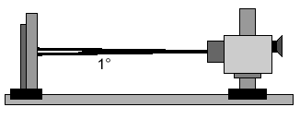
4. Optical Specification
Optical characteristics are determined after the unit has been ‘ON’ and stable for approximately 30 minutes in a dark environment at 25°C. The values specified are at an approximate distance 50cm from the LCD surface
at a viewing angle of Φ and Θ equal to 0°.
FIG. 1 presents additional information concerning the measurement equipment and method.
FIG. 1 Optical Characteristic Measurement Equipment and Method
Optical Stage(x,y)
LCD Module
Pritchard 880 or
equivalent
50cm
Table 8. OPTICAL CHARACTERISTICS
Ta=25°C, VCC=3.3V, fV=60Hz, f_{CLK}= 72.3MHz, I_{BL}= 20 mA
Parameter |  |  | Symbol | Values |  |  | Units | Notes
 |  |  |  | Min | Typ | Max
Contrast Ratio |  |  | CR | 300 | - | - |  | 1
Surface Luminance, white |  |  | L_{WH} | 170 | 200 | - | cd/m² | 2
Luminance Variation |  |  | δ _{WHITE} | - | 1.4 | 1.6 |  | 3
Response Time |  |  | Tr_{R}+ Tr_{D} | - | 16 | 25 | ms | 4
Color Coordinates
 |  | RED | RX | 0.564 | 0.594 | 0.624
 |  |  | RY | 0.323 | 0.353 | 0.383
 |  | GREEN | GX | 0.297 | 0.327 | 0.357
 |  |  | GY | 0.554 | 0.584 | 0.614
 |  | BLUE | BX | 0.121 | 0.151 | 0.181
 |  |  | BY | 0.081 | 0.111 | 0.141
 |  | WHITE | WX | 0.283 | 0.313 | 0.343
 |  |  | WY | 0.299 | 0.329 | 0.359
Viewing Angle |  |  |  |  |  |  |  | 5
 | x axis, right(Φ=0°) |  | Θr | 30 | - | - | degree
 | x axis, left (Φ=180°) |  | Θl | 30 | - | - | degree
 | y axis, up (Φ=90°) |  | Θu | 10 | - | - | degree
 | y axis, down (Φ=270°) |  | Θd | 20 | - | - | degree
Gray Scale |  |  |  |  | 2.2 |  |  | 6
<number> / 27

Slide 14
Note)
1. Contrast Ratio(CR) is defined mathematically as
Surface Luminance with all white pixels
Contrast Ratio =
Surface Luminance with all black pixels
2. Surface luminance is the average of 5 point across the LCD surface 50cm from the surface with
all pixels displaying white. For more information see FIG 1.
L_{WH} = Average(L₁,L₂, … L₅)
3. The variation in surface luminance , The panel total variation (δ _{WHITE}) is determined by measuring L_{N}
at each test position 1 through 13 and then defined as followed numerical formula.
For more information see FIG 2.
Maximum(L₁,L₂, … L₁₃)
δ _{WHITE} =
Minimum(L₁,L₂, … L₁₃)
4. Response time is the time required for the display to transition from white to black (rise time, Tr_{R}) and
from black to white(Decay Time, Tr_{D}). For additional information see FIG 3.
5. Viewing angle is the angle at which the contrast ratio is greater than 10. The angles are determined
for the horizontal or x axis and the vertical or y axis with respect to the z axis which is normal to the
LCD surface. For more information see FIG 4.
6. Gray scale specification * f_{V} = 60Hz
Gray Level | Luminance [%] (Typ)
L0 | 0.24
L7 | 0.74
L15 | 2.57
L23 | 6.75
L31 | 15.48
L39 | 32.89
L47 | 56.63
L55 | 76.95
L63 | 100
<number> / 27

Slide 15
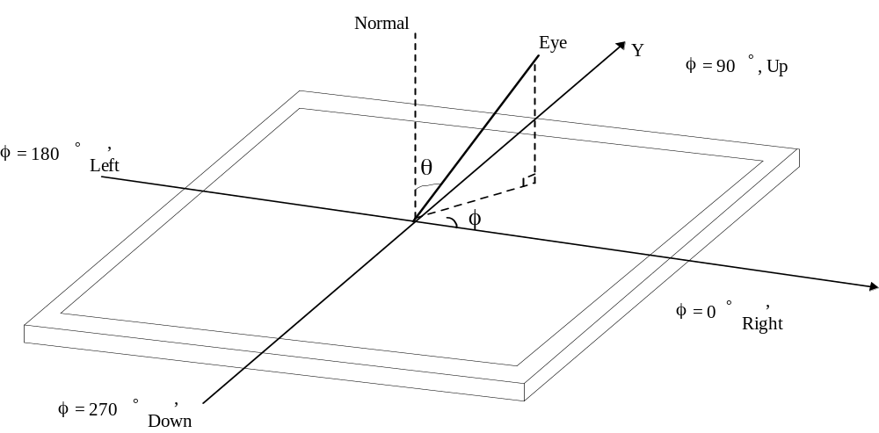
FIG. 2 Luminance
<measuring point for surface luminance & measuring point for luminance variation>
H
10mm
A
6
7
8
10mm
B
2
3
H,V
: ACTIVE AREA
V
A
9
1
10
B
: H/4 mm
: V/4 mm
11
4
12
5
13
POINTS: 13 POINTS
Active Area
FIG. 3 Response Time
The response time is defined as the following figure and shall be measured by switching the input signal for “black” and “white”.
Tr
R
Tr
D
%
100
90
Optical
Response
10
0
white
black
white
FIG. 4 Viewing angle
<number> / 27

Slide 16
5. Mechanical Characteristics
The contents provide general mechanical characteristics for the model LP101WH1. In addition the figures
in the next page are detailed mechanical drawing of the LCD.
Outline Dimension | Horizontal | 235.0 ± 0.5 mm
 | Vertical | 143.0 ± 0.5 mm
 | Thickness | 5.2mm (max)
Bezel Area | Horizontal | 226.00 mm
 | Vertical | 128.70 mm
Active Display Area | Horizontal | 222.73 mm
 | Vertical | 125.22 mm
Weight | 200g (Max.)
Surface Treatment | Anti-Glare treatment of the front polarizer
<number> / 27

Slide 17
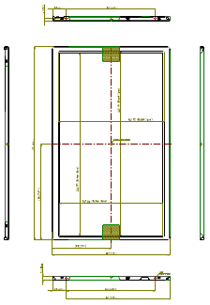
<FRONT VIEW>
Note) Unit:[mm], General tolerance: ± 0.5mm
<number> / 27

Slide 18
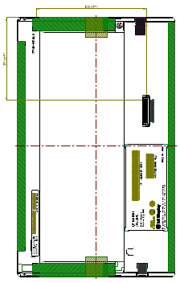
<REAR VIEW>
Note) Unit:[mm], General tolerance: ± 0.5mm
<number> / 27

Slide 19
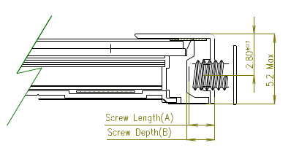
[ DETAIL DESCRIPTION OF SIDE MOUNTING SCREW ]
* Mounting Screw Length (A)
= 1.5(Min) /1.8(Max)
* Mounting Screw Hole Depth (B)
= 1.8(Min)
* Mounting hole location : 2.8(typ.)
* Torque : 2.0 kgf.cm(Max)
(Measurement gauge : torque meter)
Section A-A
Notes : 1. Screw plated through the method of non-electrolytic nickel plating is preferred
to reduce possibility that results in vertical and/or horizontal line defect due to
the conductive particles from screw surface.
<number> / 27

Slide 20
6. Reliability
Environment test condition
No. | Test Item | Conditions
1 | High temperature storage test | Ta= 60°C, 240h
2 | Low temperature storage test | Ta= -20°C, 240h
3 | High temperature operation test | Ta= 50°C, 50%RH, 240h
4 | Low temperature operation test | Ta= 0°C, 240h
5 | Vibration test (non-operating) | Sine wave, 10 ~ 500 ~ 10Hz, 1.5G, 0.37oct/min 3 axis, 1hour/axis
6 | Shock test (non-operating) | Half sine wave, 180G, 2ms one shock of each six faces(I.e. run 180G 6ms for all six faces)
7 | Altitude operating storage / shipment | 0 ~ 10,000 feet (3,048m) 24Hr 0 ~ 40,000 feet (12,192m) 24Hr
{ Result Evaluation Criteria }
There should be no change which might affect the practical display function when the display quality
test is conducted under normal operating condition.
<number> / 27

Slide 21
7. International Standards
7-1. Safety
a) UL 60950-1:2003, First Edition, Underwriters Laboratories, Inc.,
Standard for Safety of Information Technology Equipment.
b) CAN/CSA C22.2, No. 60950-1-03 1st Ed. April 1, 2003, Canadian Standards Association,
Standard for Safety of Information Technology Equipment.
c) EN 60950-1:2001, First Edition,
European Committee for Electrotechnical Standardization(CENELEC)
European Standard for Safety of Information Technology Equipment.
7-2. EMC
a) ANSI C63.4 “Methods of Measurement of Radio-Noise Emissions from Low-Voltage Electrical and
Electrical Equipment in the Range of 9kHZ to 40GHz. “American National Standards Institute(ANSI),
1992
b) C.I.S.P.R “Limits and Methods of Measurement of Radio Interface Characteristics of Information
Technology Equipment.“ International Special Committee on Radio Interference.
c) EN 55022 “Limits and Methods of Measurement of Radio Interface Characteristics of Information
Technology Equipment.“ European Committee for Electrotechnical Standardization.(CENELEC), 1998
( Including A1: 2000 )
<number> / 27

Slide 22
8. Packing
8-1. Designation of Lot Mark
a) Lot Mark
A
B
C
D
E
F
G
H
I
J
K
L
M
A,B,C : SIZE(INCH) D : YEAR
E : MONTH F ~ M : SERIAL NO.
Note
1. YEAR
Year
2001
2002
2003
2004
2005
2006
2007
2008
2009
2010
Mark
1
2
3
4
5
6
7
8
9
0
2. MONTH
Month
Jan
Feb
Mar
Apr
May
Jun
Jul
Aug
Sep
Oct
Nov
Dec
Mark
1
2
3
4
5
6
7
8
9
A
B
C
b) Location of Lot Mark
Serial No. is printed on the label. The label is attached to the backside of the LCD module.
This is subject to change without prior notice.
8-2. Packing Form
a) Package quantity in one box : 40 pcs
b) Box Size : 395mm × 390mm × 309mm
<number> / 27

Slide 23
9. PRECAUTIONS
Please pay attention to the followings when you use this TFT LCD module.
9-1. MOUNTING PRECAUTIONS
(1) You must mount a module using holes arranged in four corners or four sides.
(2) You should consider the mounting structure so that uneven force (ex. Twisted stress) is not applied to the
module. And the case on which a module is mounted should have sufficient strength so that external
force is not transmitted directly to the module.
(3) Please attach the surface transparent protective plate to the surface in order to protect the polarizer.
Transparent protective plate should have sufficient strength in order to the resist external force.
(4) You should adopt radiation structure to satisfy the temperature specification.
(5) Acetic acid type and chlorine type materials for the cover case are not desirable because the former
generates corrosive gas of attacking the polarizer at high temperature and the latter causes circuit break
by electro-chemical reaction.
(6) Do not touch, push or rub the exposed polarizers with glass, tweezers or anything harder than HB
pencil lead. And please do not rub with dust clothes with chemical treatment.
Do not touch the surface of polarizer for bare hand or greasy cloth.(Some cosmetics are detrimental
to the polarizer.)
(7) When the surface becomes dusty, please wipe gently with absorbent cotton or other soft materials like
chamois soaks with petroleum benzene. Normal-hexane is recommended for cleaning the adhesives
used to attach front / rear polarizers. Do not use acetone, toluene and alcohol because they cause
chemical damage to the polarizer.
(8) Wipe off saliva or water drops as soon as possible. Their long time contact with polarizer causes
deformations and color fading.
(9) Do not open the case because inside circuits do not have sufficient strength.
9-2. OPERATING PRECAUTIONS
(1) The spike noise causes the mis-operation of circuits. It should be lower than following voltage :
V=± 200mV(Over and under shoot voltage)
(2) Response time depends on the temperature.(In lower temperature, it becomes longer.)
(3) Brightness depends on the temperature. (In lower temperature, it becomes lower.)
And in lower temperature, response time(required time that brightness is stable after turned on) becomes
longer.
(4) Be careful for condensation at sudden temperature change. Condensation makes damage to polarizer or
electrical contacted parts. And after fading condensation, smear or spot will occur.
(5) When fixed patterns are displayed for a long time, remnant image is likely to occur.
(6) Module has high frequency circuits. Sufficient suppression to the electromagnetic interference shall be
done by system manufacturers. Grounding and shielding methods may be important to minimized the
interference.
<number> / 27

Slide 24
9-3. ELECTROSTATIC DISCHARGE CONTROL
Since a module is composed of electronic circuits, it is not strong to electrostatic discharge. Make certain that
treatment persons are connected to ground through wrist band etc. And don’t touch interface pin directly.
9-4. PRECAUTIONS FOR STRONG LIGHT EXPOSURE
Strong light exposure causes degradation of polarizer and color filter.
9-5. STORAGE
When storing modules as spares for a long time, the following precautions are necessary.
(1) Store them in a dark place. Do not expose the module to sunlight or fluorescent light. Keep the
temperature between 5°C and 35°C at normal humidity.
(2) The polarizer surface should not come in contact with any other object.
It is recommended that they be stored in the container in which they were shipped.
9-6. HANDLING PRECAUTIONS FOR PROTECTION FILM
(1) When the protection film is peeled off, static electricity is generated between the film and polarizer.
This should be peeled off slowly and carefully by people who are electrically grounded and with well
ion-blown equipment or in such a condition, etc.
(2) The protection film is attached to the polarizer with a small amount of glue. If some stress is applied
to rub the protection film against the polarizer during the time you peel off the film, the glue is apt to
remain on the polarizer.
Please carefully peel off the protection film without rubbing it against the polarizer.
(3) When the module with protection film attached is stored for a long time, sometimes there remains a
very small amount of glue still on the polarizer after the protection film is peeled off.
(4) You can remove the glue easily. When the glue remains on the polarizer surface or its vestige is
recognized, please wipe them off with absorbent cotton waste or other soft material like chamois
soaked with normal-hexane.
<number> / 27

Slide 25
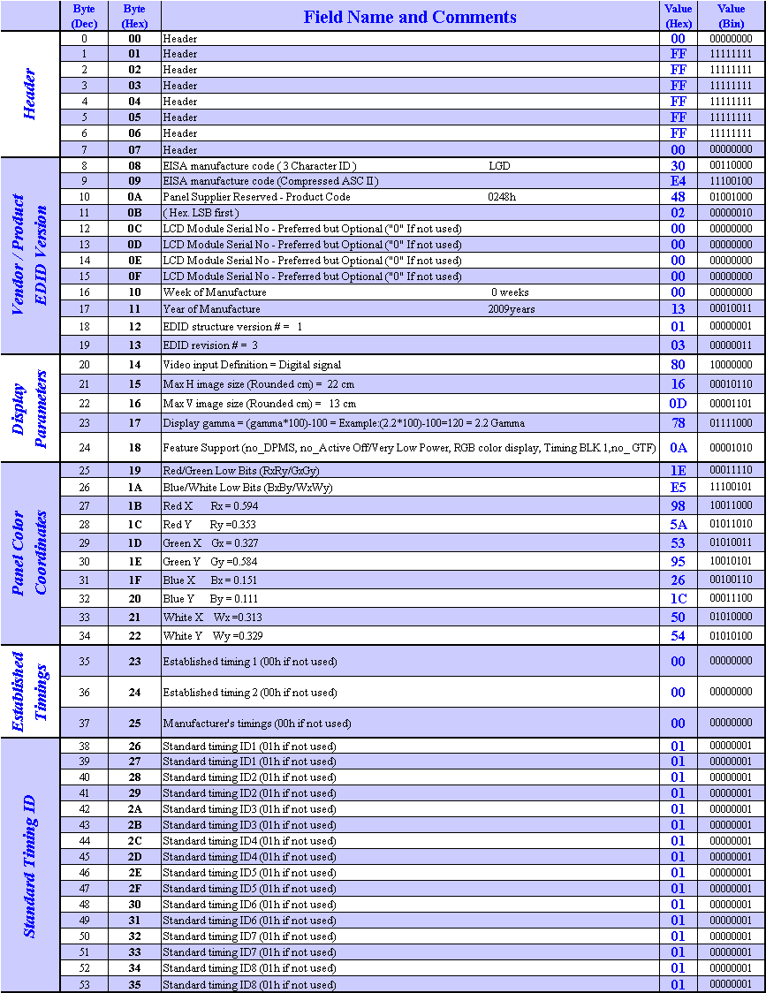
APPENDIX A. Enhanced Extended Display Identification Data (EEDIDTM) 1/3
<number> / 27

Slide 26
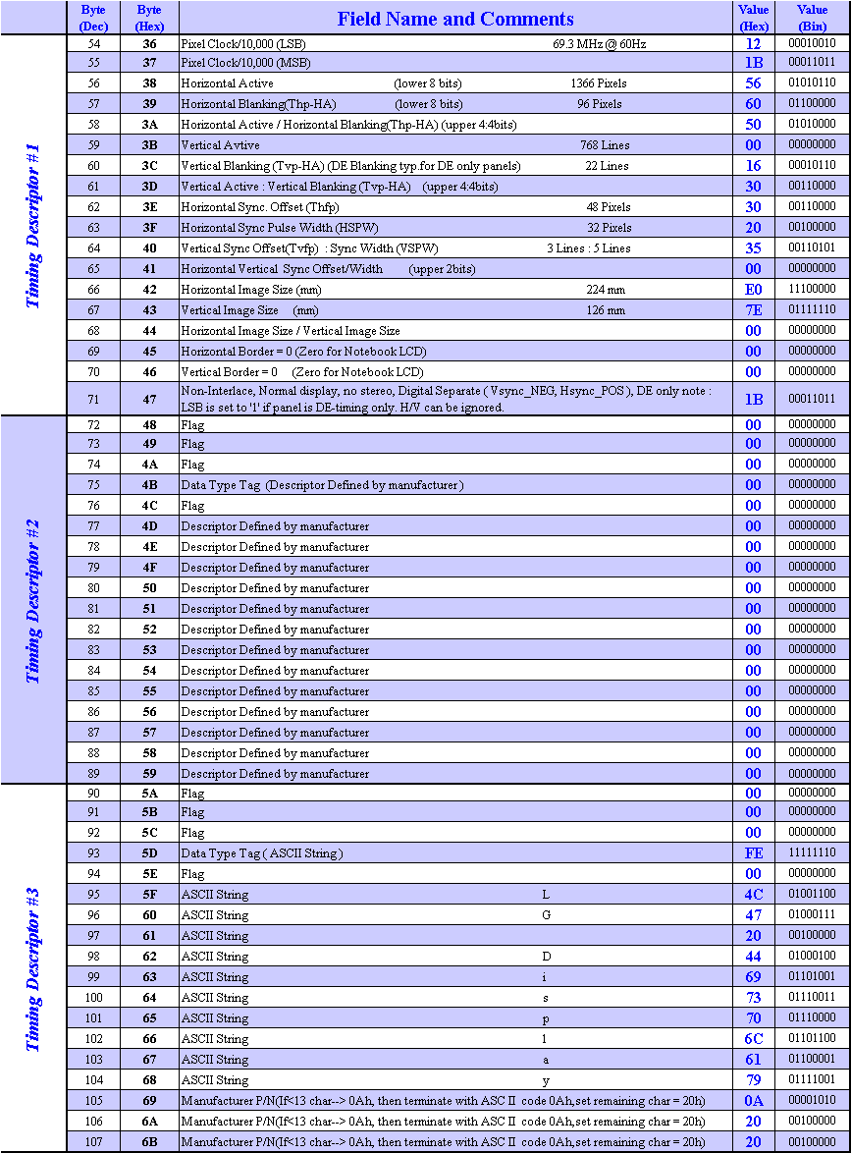
APPENDIX A. Enhanced Extended Display Identification Data (EEDIDTM) 2/3
<number> / 27

Slide 27
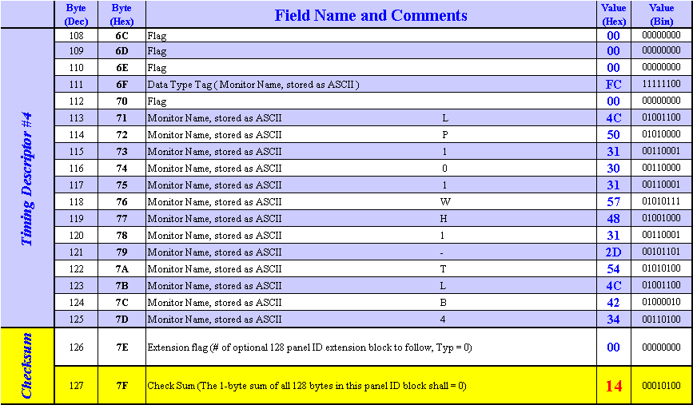
APPENDIX A. Enhanced Extended Display Identification Data (EEDIDTM) 3/3
<number> / 27

